Slide 1
Software Engineering
Acceptance Criteria

Slide 2

Acceptance Criteria (AC)
EXPLAIN
From scrumalliance.org:
“Acceptance criteria are defined as the conditions that must be satisfied for a single product, user story, or increment of work to be accepted.
These conditions are pass/fail – no halfway measures.
AC are often a set of statements. These should be:
Clear, so that everyone understands them
Concise, so that there’s no ambiguity
Testable or verifiable
Focused on providing customer-delighting results”
Notes:
2min

Slide 3
Acceptance Criteria (AC)
EXPLAIN
From scrumalliance.org:
AC is not “how” something is made, it’s the details of “what” it does. For example:
✔️ Users can pay with ABA or MasterCard at checkout.
We don’t say how to do it, for example:
❌ Install a Laravel plugin that allows you to create a checkout page.
❌ Write HTML that makes it possible to pay with ABA or MasterCard.
It’s up to the developers on the scrum team to decide how to fulfil the acceptance criteria.
Notes:
2min

Slide 4
EXPLAIN
Example Acceptance Criteria (from last week)
Story: “As a customer, I want to search for shows, so that I can decide what to watch.”
Acceptance Criteria:
The search page should be reachable from the main screen.
The search should work on either name, or date, or both.
The results page should display the show name, description, dates and times.
If there are more than 30 results, they should be displayed across multiple pages, with “Previous” and “Next” buttons.
If there are no results, a message should display “No matching results found.”
If a show is sold out, it should appear in the results with a “SOLD OUT” sign by it.
Search results should appear within two seconds of the user pressing the Search button.

Slide 5
Exercise (30min)
ACTIVITY
Individually, write some Acceptance Criteria for the first one of your group’s stories.
When you are done (in 10 minutes) compare them with the rest of your team and discuss which ones to keep, drop or merge. Make a final list in neat writing or laptop.
The QA Manager will then present the group’s ACs to the room.

Slide 6
Software Engineering
User Stories to Subtasks

Slide 7

HOW TO BREAK DOWN A USER STORY INTO SUBTASKS?

Slide 8
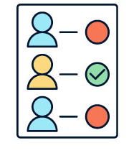
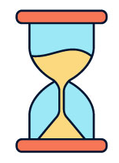

EXPLAIN
What is subtasking?
Subtasking is the process of creating tasks to fulfil a user story.
We also estimate the duration of the work.
Easy to estimate
Easy to assign
Easy to follow

Slide 9


ACTIVITY
As a user, I want to search the available products, so that I can buy what I’m looking for.
15 MIN
In teams, break down this user story into subtasks
Use Post-Its
Estimate how long each subtask will take
Find subtasks for each category, for example:
Mock-up
Specifications
HTML, JS, (Controller)
Controller, Database, Model
Analyse
Design
Front End
Back End
Test
Understand what kind of search the user wants, and what we can provide
If data is available, show it
If not display error
Don’t show products not matching the search
…etc…

Slide 10
CORRECTION
As a user, I want to search the available products, so that I can buy what I’m looking for.
Analyse
Understand the user’s search requirements (1 hour * 3 people = 3h)
The deliverable for this is the contents of the Design subtask.
Design
Design the search view (1.5 days)
Do you split this up further into Figma vs HTML/CSS subtasks?
Front End
Create the view (4 hours)
Create the controller (4 hours)
Back End
Update the model with new queries (3 hours)
Test
Write and document Test Cases (1 day)
Run the Test Cases (2 hours)

Slide 11
EXPLAIN
How do we estimate task time?
Most programming tasks you do will be things you haven’t done before.
This will still be true after you graduate!
Task estimation is a skill you learn by practicing. During your project, compare your estimated times to your actual times. Are you under- or over-estimating?
We won’t deduct grades for estimates that don’t match the actual times!

Slide 12
EXPLAIN
How do we estimate task time?
The act of estimating a task is also the act of understanding it
If you don’t understand a subtask:
Can it be divided into smaller pieces?
What parts of it do you understand? Can you estimate them?
Is it difficult enough to make a “Spike” task to understand it?
A Spike is a special kind of task, to research another task.
Its deliverable isn’t a product feature, but a written report in another JIRA ticket.

Slide 13
ACTIVITY
As a customer, I want the website to be secure, so that my data is not stolen by hackers.
25 MIN
In teams, break down this user story into subtasks
Use Post-Its, make estimates
Use the Internet to research things you need for security, but only enough to make your subtasks! You don’t need to understand 100% at this stage.
Find subtasks for each category. These may be different categories to the last exercise!
Database
?
Research
Back End
Test

Slide 14
CORRECTION
As a customer, I want the website to be secure, so that my data is not stolen by hackers.
Research
Research about cybersecurity
Back End
Protect from SQL injection
Database
Make sure passwords are encrypted
?
Other security item…

Slide 15
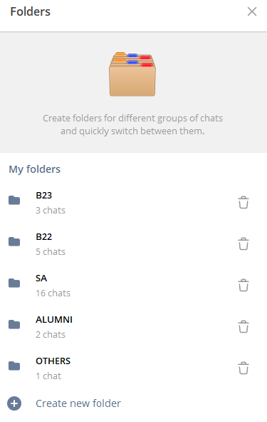
ACTIVITY
As a user, I want to manage my Telegram groups into folders, so that I can find them easier
30 MIN
In teams of 2/3, break down this user story into subtasks
Find sub tasks for each category
Estimate times

